Slide 1
BBDS Group # 11 Disease Outbreak Tracking Data Source: News Headlines
American Institute of Health

Slide 2
INTRODUCTION OF THE TEAM
Moumine Yaro, Global Health Supply Chain Specialist
Romana Akram, DevOps Engineer/Research Analyst
Danish Abbasi, Healthcare and Supply Chain
Sadiya Motorwala, Data Quality Lead (Endo Pharmacy Technician)
Veronica Okwoche, Nutrition Consultant/Research Biologist
Sri Chava, Network Engineer
Azouz Founounou, Industrial Technician

Slide 3
BUSINESS PROBLEM/BACKGROUND
The American Institute of Health monitors disease epidemics in both foreign and domestic lands.
A critical component of the monitoring process involves analysis of published news data. Each day, the Institute receives hundreds of news headlines describing disease outbreaks in various locations.
The news headlines are too numerous to be analyzed by hand.

Slide 4
OBJECTIVE
Our objective is to explore, sort and analyze data from various sources in order to prevent, control, and eliminate a disease outbreak domestically and internationally with aim to reach conclusions to optimize disease tracking processes and for decision support.
Location Cluster
Sort and Analyze
Track Disease Outbreak

Slide 5
DESCRIPTIVE QUESTIONS
What were the number of cases impacted by disease outbreak?
Where was the location of disease outbreak?
How many diseases were reported by news headline?

Slide 6
PREDICTIVE QUESTIONS
Where is the disease most likely to spread next?
How widespread the disease is going to be?
Which season shows the largest impact?
What is the probability of this disease turning into a pandemic, and ultimately an epidemic?

Slide 7
ABT
Disease Outbreak Tracking
Epidemic Alert (Y/N)
News
LOCATION
POPULATION
DISEASE
TIME
Total population
Disease Name
Year
Continent
Number of cases
Vaccination rate
Type of Disease
Month
Country
Vaccination Rate
City
Day
Mortality rate
Patient Data

Slide 8

BUSINESS UNDERSTANDING
AS-IS AND TO-BE STATE
Currently, we are monitoring disease outbreak in US and rest of the world by identifying number of cases and locations impacted.
Identify the largest clusters inside and outside US, the american institute will utilize this data to plan for the control of the disease and notify other stakeholders.

Slide 9
Exploratory Data Analysis (EDA)
Source of data is News Headlines
Available as a text file which is unstructured data
Each news headline is present as a new line, separated by a carriage return
Total rows in the data each representing a news headline = 650
Total number of words = 4222
Noisy data: 1174
Stop words = 1154
Punctuation = 20

Slide 10
EDA Continued..
Top 5 diseases occurring most frequently in the data are:
Zika :227
Hepatitis(A,B,C,E):57
Flu : 28
Mad Cow : 19
Malaria : 18
Almost 45% Zika cases are reported out of 650 headlines
Non stop words without punctuation = 3048

Slide 11
Descriptive Questions in relation to the data
What were the number of cases impacted by disease outbreak?
No number of cases reported for every news headline.
Where was the location of disease outbreak?
How many diseases were reported by news headline?
Identify the top 5 most reported diseases.

Slide 12
Predictive Questions in relation to the data
Where is the disease most likely to spread next?
How widespread the disease is going to be?
Which season shows the largest impact?
Data does not display any dates to support this analysis.
What is the probability of this disease turning into a pandemic, and ultimately an epidemic?

Slide 13
Issues discovered while exploring the data
Both lower and upper case present in the data
Some diseases appear in the data with their synonyms e.g. Influenza exists both as flu and influenza in the data.
Only few headlines have number of cases reported in respective areas
Data has punctuations and unrecognisable special characters e.g
Several stop words in the data
Whitespaces and extensions of root words

Slide 14
Continued..
Some words are broken down into more than 1 word e.g: New York city as “New”, “York” and “city” and Hepatitis C as “Hepatitis” and “C”
No uniformity in headlines, cases are reported at city, country or state level.
Same city name exist in different states so hard to find exact location e.g. Atlanta city exists in Georgia and in Texas
Some headlines mention “Could Zika Reach New York City?” which could lead to misinterpretation of data

Slide 15
Solution🡪Data Cleaning
We used Python to clean our data
Make all the letters to lower case
Remove white spaces, punctuation and special characters
Remove stop words using nltk library
Extract root words using Lemmatisation from nltk library (Stemming was tried but was not accurate)
Tokenise words to identify frequency using nltk library
Converted the data into a dataframe

Slide 16
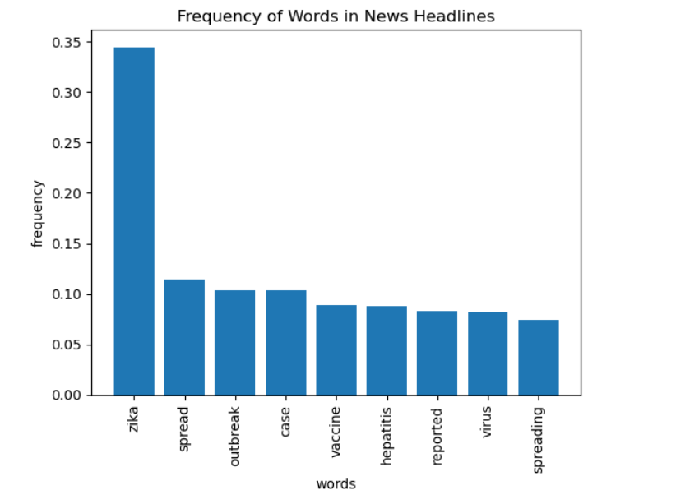
Data Visualisation

Slide 17
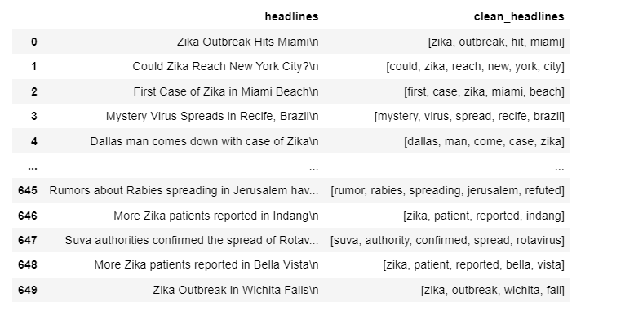
NLP and future anticipated actions
Notes:
Column 3 was contains tokenised words extracted from each news headline in a list.
The future work will involve extracting location from column 3 and putting it in a new column “location” and extracting diseases and adding it similarly to a new column “disease”

Slide 18
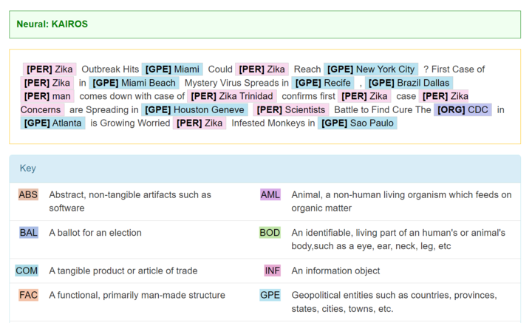
NLP and future anticipated actions
Notes:
https://cogcomp.seas.upenn.edu/page/demo_view/NEREnglish

Slide 19






COMMUNICATIONS
We used Whatsapp, Email, Slack, Google drive, Git, and Zoom …..but mainly 8x8.

Slide 20
References
https://cogcomp.seas.upenn.edu/page/demo_view/NEREnglish
https://chat.openai.com/chat
https://towardsdatascience.com/whatnlpscientistsdo-905aa987c5c0
https://www.knowledgehut.com/blog/data-science/nlp-data-science

Slide 21
THANKS!
Do you have any questions?
We are here for you!!
BBDS – Group 11 (Disease Outbreak Tracker)

